Slide 1
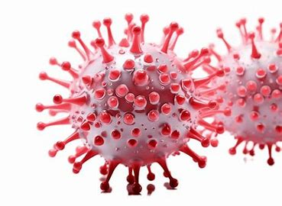
COVID-19 Global Spread Analysis
Findings and Public Health Insights
Presented by: Mercy E. Festus
Cohort 2, 3MTT Data Science Fellow.

Slide 2
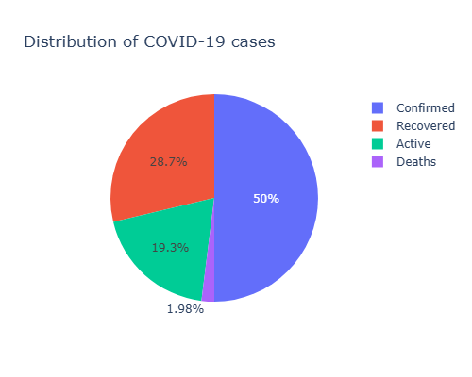
Overview of the Pandemic
Countries Affected: 187
Regions Most Impacted:
Americas: 54% of confirmed cases
Europe: 56 countries reporting cases of viral infections
Global Statistics:
Confirmed Cases: 50%
Recovery Rate: 29%
Active Cases: 19%
Death Rate: 2%

Slide 3
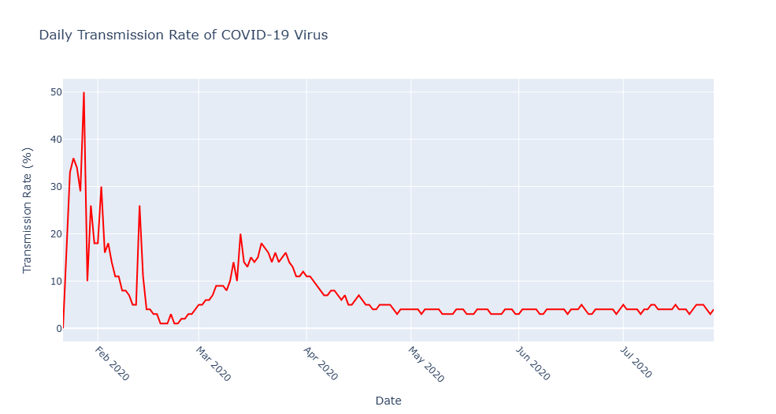
Highlights of Transmission Cases
Peak Transmission Rate recorded: 50% (January 28th, 2020)
Subsequent rapid decline:
Dropped 40% the following day
Progressive decline from March 19th
Gradually, the transmission rate declined, rising to its final peak at 26%, before declining rapidly to 3-4% in the months that followed.
Implications:
Initial issues in immediate virus control
Gradual effectiveness of intervention measures over time
There was a drop in new infections over time

Slide 4
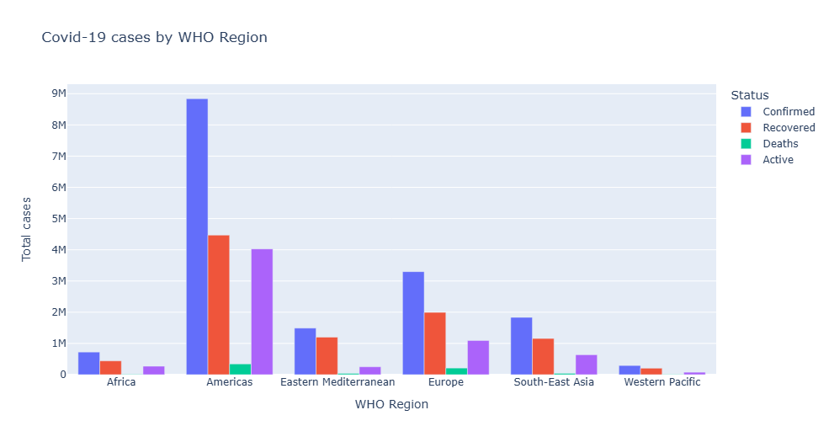
Regional Analysis
Highlights on Top Regions
Americas Region
Highest case numbers
63% of all active cases
Challenges in controlling the spread of the virus
Emerging Hotspots
South East Asia saw an increase in the number of new cases recorded
Potential new transmission waves

Slide 5
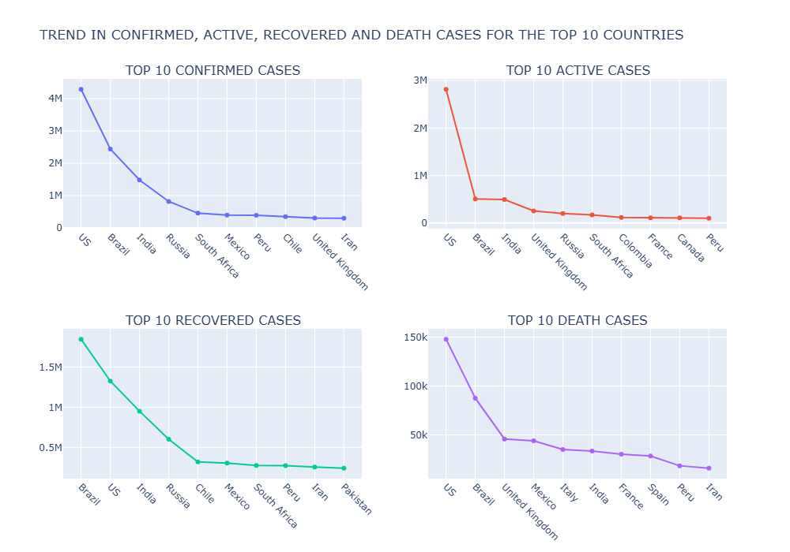
Country Analysis
United States of America -
Highest number of cases recorded
Faced significant healthcare challenges
Brazil -
High recovery rate (1.8 million recoveries recorded)
Potential factors:
Coordinated healthcare response
Effective treatment protocols
Early intervention strategies implemented.

Slide 6
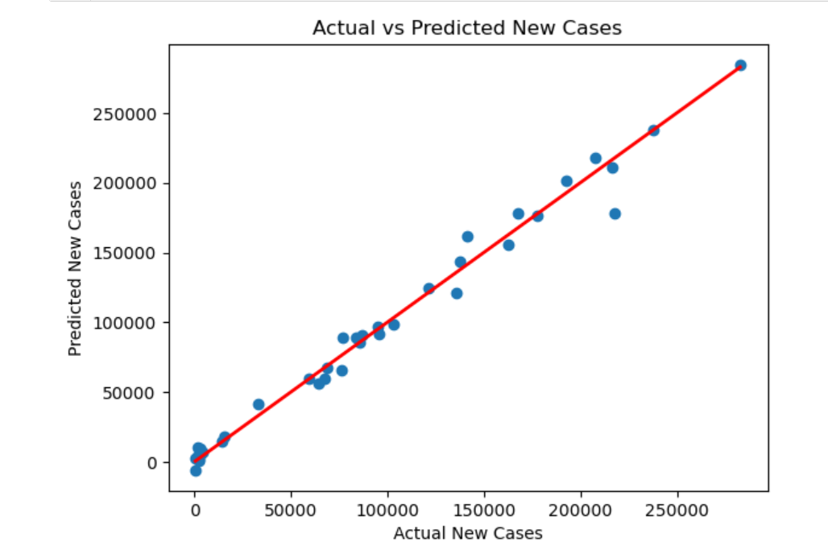
Predictive Modeling
Models used
Logistic Regression
Random Forest Regressor
Key Metrics:
R-Squared value: 0.99
Model explains 99% of changes in new cases
Mean Squared Error: 90,256,812.65
Indicates some variability in individual predictions

Slide 7
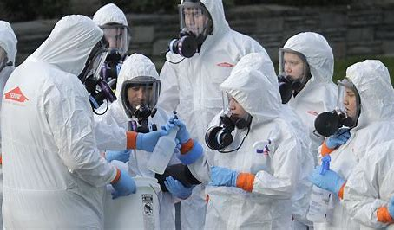

Public Health Recommendations
Strategic Action Points
Global Coordination
a. Standardized international protocols
b. Enhanced communication networks
Healthcare preparedness
a. Scalable medical infrastructure
b. Flexible resource allocation
3. Monitoring Systems
a. Real-time disease tracking
b. Early warning mechanisms

Slide 8
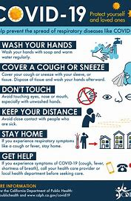
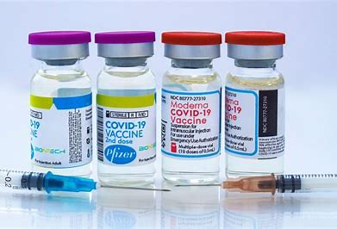
Research and Future Preparedness
Research Priorities
a. Viral transmission understanding
b. Rapid vaccine development
2. Public Health Education
a. Comprehensive awareness campaigns
b. Clear communication strategies
3. Adaptive response mechanisms
4. Global health collaboration

